Slide 1
Cloud Native Ops Workshop
Version 1.0
March, 2019

Slide 2

Welcome
Cloud Native Ops Workshop
Seattle - March 12th, 2019

Slide 3
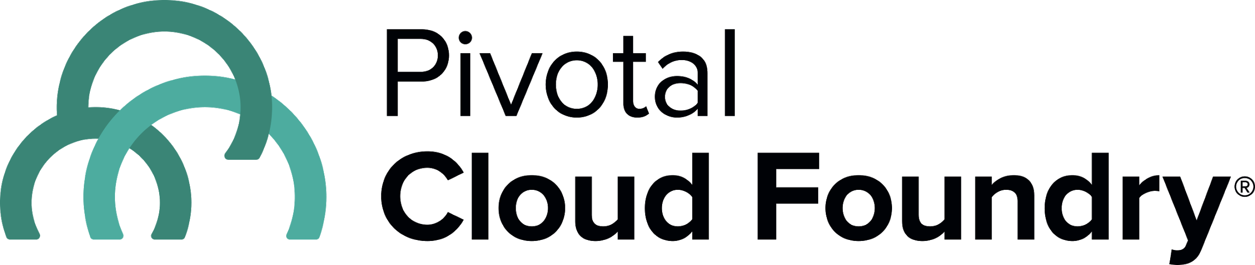
PCF Operator Workshop - Agenda
Start - End Activity
9:00 - 9:30 Breakfast and Intros
9:30 - 10:00 Cloud Native Intro
10:00 - 10:45 PCF architecture and operations
10:45 - 11:00 Break
11:00 - 11:30 ‘Platform as a Product’
11:30 - 12:00 Demo: PCF Automation & OpsMan
12:00 - 12:15 Labs: CF Dev experience
12:15 - 1:00 Lunch (Finish Labs)
1:00 - 1:30 Demo: Observability
1:30 - 2:00 Security
2:00 - 2:30 Lab: Security
2:30 - 2:45 Break
2:45 - 3:30 Demo: Power of BOSH
3:30 - 3:45 Demo: CI/CD
3:45 - 4:00 Wrap up
Logistics
Targeted for Operators & Infrastructure Architects
Full Day
Demo Environment
Breakfast and Lunch Provided
Q&A Throughout
In Person only
Notes:
Other Topics
Pre-Requisites - IaaS Setup
BURA
HA/DR
Monitoring
Scaling
Integrations

Slide 4
Logistics
Breaks
Lunch
‘The Facilities’
Email & Cell Phones
Questions
Lab Setup
Follow Ups

Slide 5
Speakers
Pivotal
Will Arroyo - Sr. Platform Architect
Brent Shepherd - Account Exec.
Derek Beauregard - Regional Director, PA

Slide 6
Introductions

Slide 7
Cloud Native Ops Workshop
Cloud Native Introduction
Version 1.0
March, 2019

Slide 8

http://www.boeing.com//resources/boeingdotcom/defense/fa-18_super_hornet/images/fa18_super_hornet_new_1280x720.jpg
Software is an Offensive Weapon
Notes:
Software is an offensive weapon
Its how companies compete, innovate, and build new customer experiences.
Every company is a "Software Company", no matter the company or industry.
Software is the most important differentiator companies have today.
‘Software is changing (perfect storm)… yes it’s always changing but:
Mobile, always connected story (from starting w/ Call center agents)
Mobile First
Always connected
No downtime
Scale (huge number of users)
Updates (Average, top 50 apps: update once a month)
3 key drivers
Software is free(ly available) - OSS
Compute is free
Information is free (Internet)
Results
IT rule the world
Startups have no barrier to entry
*https://sensortower.com/blog/25-top-ios-apps-and-their-version-update-frequencies

Slide 9
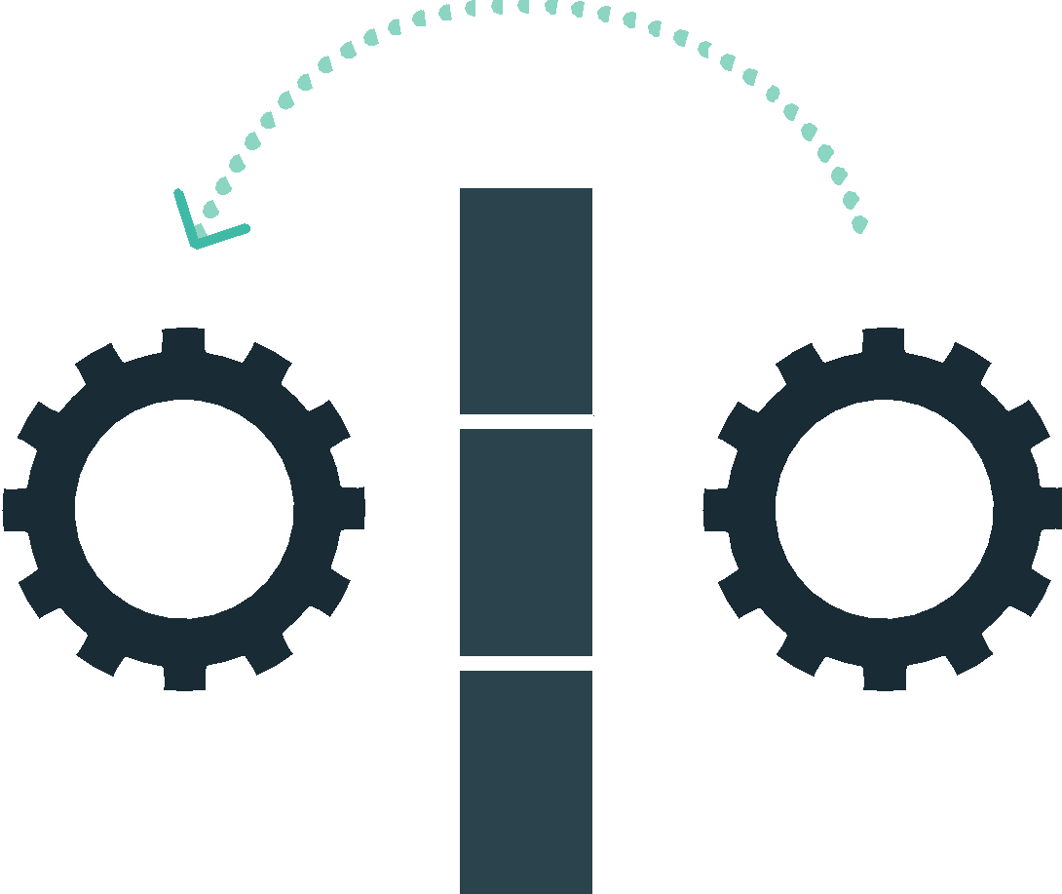
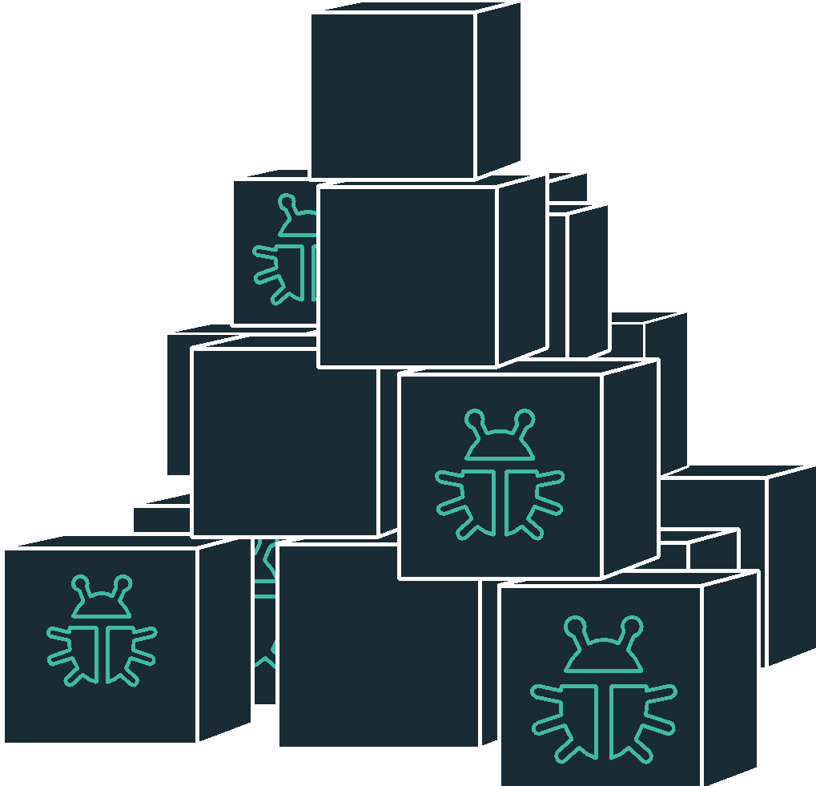
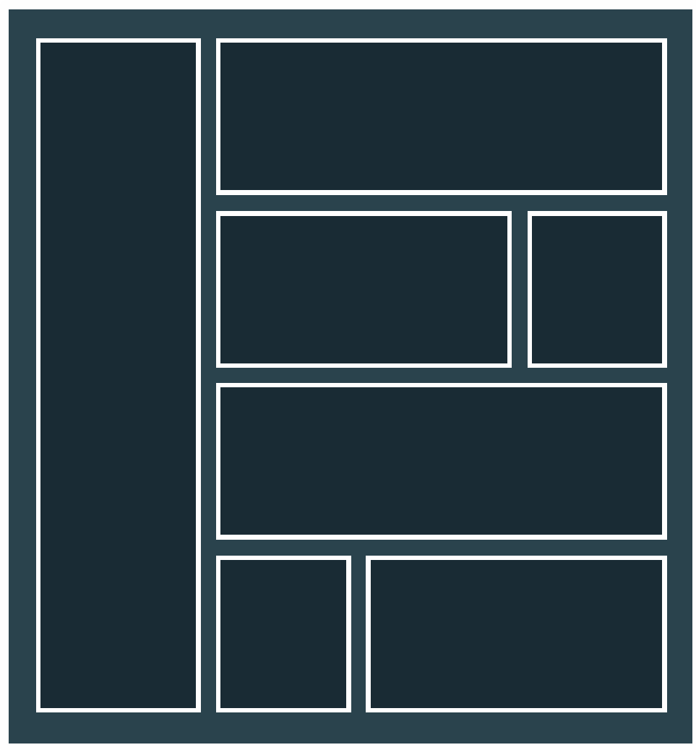
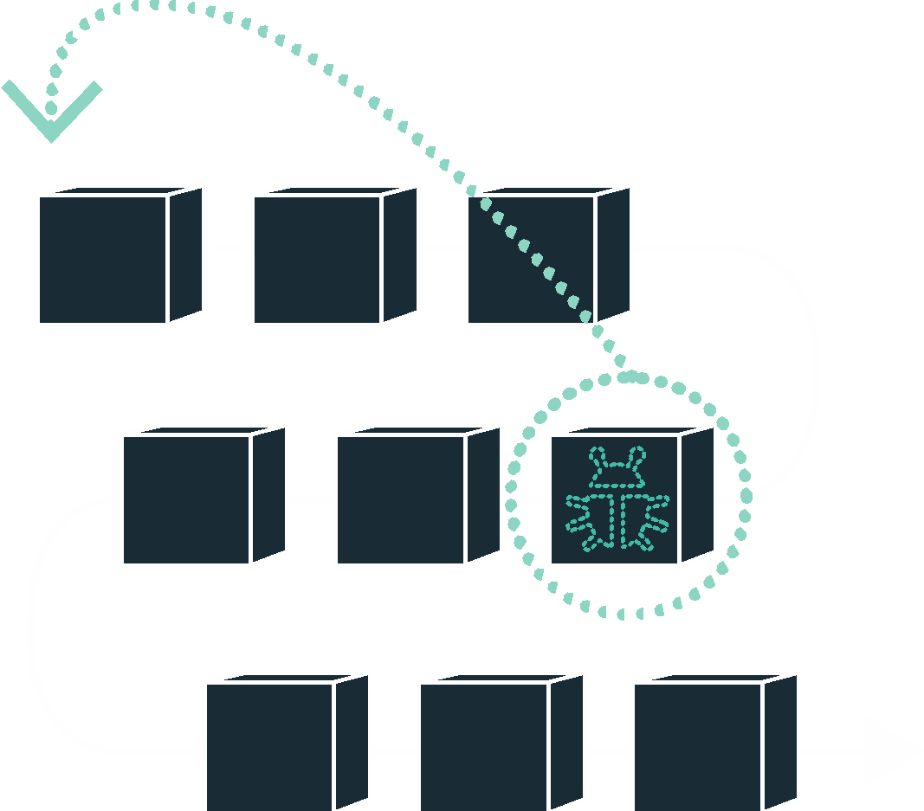
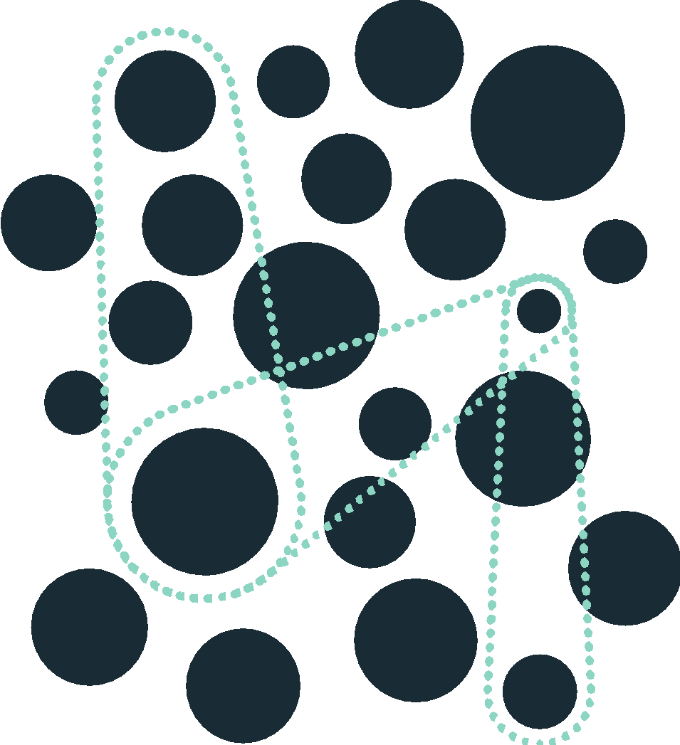
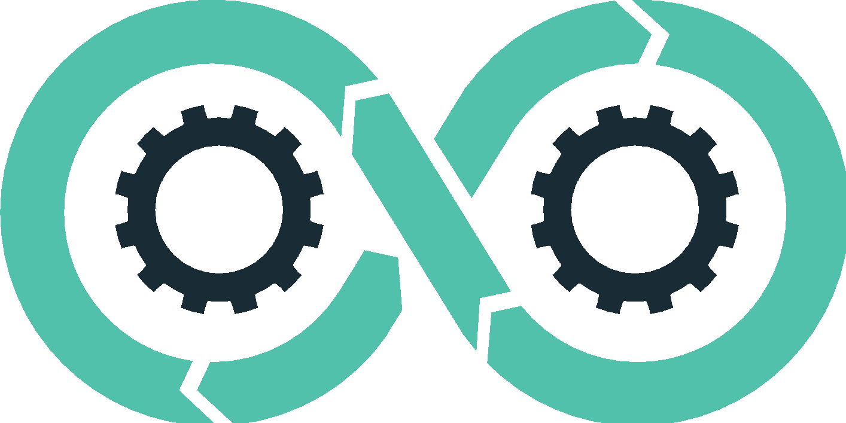
DevOps
Continuous Delivery
Microservices
Not my problem
Separate tools, varied incentives, opaque process
Release once every 6 months
More Bugs in production
Tightly coupled components
Slow deployment cycles waiting on integrated tests teams
Cloud Native Platform
Shared responsibility
Common incentives, tools, process and culture
Release early and often
Higher Quality of Code
Loosely coupled components
Automated deploy without waiting on individual components

Slide 10
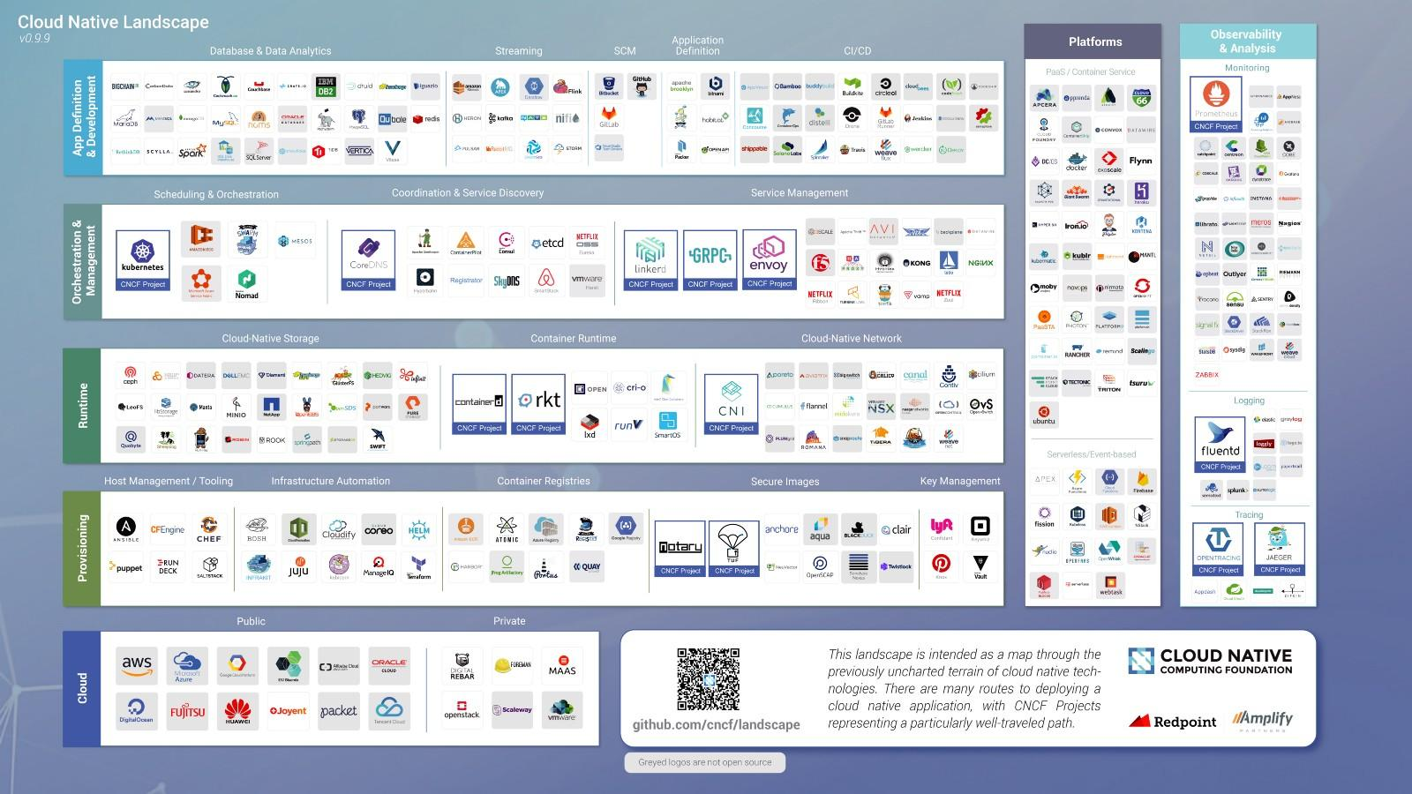

Slide 11
IT Ops Spends Time Building Snowflakes
Request VMs
Request Network
Request Software Install
Request Database
Random Network Troubleshooting
DAYS
14
4
4
8
6
11
40
14
60
2
Nearly 6 months later
Production
Random Middleware/OS Troubleshooting
Develop App
User Acceptance Testing
QA/Production Deploy Pipeline
Scale Up/Down
Notes:
As an example, here is a sample company that is bogged with too much legacy culture, process, and technology. In fact, this is quite generous. You know, it takes some companies three months to request a new VM, and once all is said and done, if they even have User/QA, the security teams have to do an internal review for vulnerability and compliance. Its no wonder that companies are falling behind! Sometimes I think all the process in place is just there to keep people employed, and a lot of this kind of thing has to do with company culture and legacy everything. Changing for the long run, only elevates everyone to levels of business which realizes the greatest value.

Slide 12
The Developer DREAM Haiku
Here is my source code,
Run it in the Cloud for me,
I do not care how
Notes:
An important and in-demand resource these days – Your developers. This is what they really want – to execute on innovation strategic goals without the burden of repetitive tasks, outdated process, and technology which only creates barricades in front of their mission to get into the flow.

Slide 13
The IT Operator Reality Haiku
It is not enough just to deploy something
That’s only Day One
You have to deploy again, and again, and again
Notes:
An important and in-demand resource these days – Your developers. This is what they really want – to execute on innovation strategic goals without the burden of repetitive tasks, outdated process, and technology which only creates barricades in front of their mission to get into the flow.

Slide 14
The Sys Admin’s Dream Haiku
Here are my servers,
go make them a Platform,
I do not care how
Notes:
What makes Cloud Foundry so powerful is it provides your developers with the speed
An important and in-demand resource these days – Your developers. This is what they really want

Slide 15
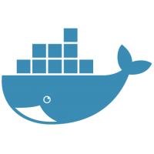
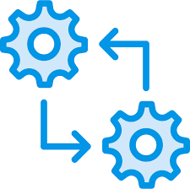
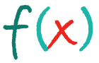

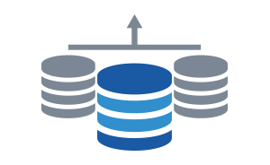

There are many ways to package and run
workloads in the cloud
Containers
Batches
Event-driven Functions
Microservices
Data Services
Monolithic Applications
Notes:
It is important to understand that workloads have, and always will, come in many shapes and sizes. Moving to the cloud does not change this fact - therefore any viable cloud-based solution must provide mechanisms to run workloads that vary. Starting with existing monolithic applications that are highly customized, cloud providers must offer methods to deploy everything from containers to serverless functions. We’ll get into the details about how Pivotal Cloud Foundry specifically addresses each.

Slide 16
Your goal: choose the right runtime for each workload
Containers
Batches
Event-driven Functions
Microservices
Data Services
Monolithic Applications
Container
Orchestrator (CaaS)
Application Platform
(PaaS)
Serverless Functions
(FaaS)
IaaS
Notes:
What we first want to do is define the major types of “as-a-service” paradigms, and then we can talk about what we offer. A couple of points:
Container Orchestration focuses on allowing organizations to package applications with some level of customizations, but with an agreed upon line of demarcation between what the infrastructure provides, and what the packaging of the application must provide.
Application Platforms, such as Pivotal Cloud Foundry, should provide everything required to build and run a complex system of interconnected microservices and containers. Orchestration, metrics, scalability, and all other “-ilities” should be provided. The end game here is to give developers a place to safely deploy applications in a consistent manner.
Serverless Functions refer to the ability to put a single set of reusable actions into an ephemeral container, and then host that independently from other components in the datacenter.

Slide 17
Choose the right tool for the job
Container
Orchestrator
Application Platform
Serverless Functions
Developer
Provides
CONTAINER
APPLICATION
FUNCTION
Tool
Provides
Container Scheduling
Primitives for Network, Routing, Logs & Metrics
Container Orchestrator
Container Orchestrator
Container Image & build
L7 Network & Routing
Logs, Metrics, Monitoring
Services Marketplace
Team, Quotas & Usage
Function execution
Function scaling
Event stream bindings
IaaS
Notes:
Each tool has its own purpose. We should be careful that we articulate the value each tool brings to the table and what it’s strengths and weaknesses are. We need to make sure to point out that as you move “up the stack” from Containers to Serverless, you have less control, but you have less that you are responsible for as well. Users need to make sure they’re picking the right tool for the job they need to accomplish.
Examples:
If you need to be able to run your application on a specific port, or need to co-mingle a couple applications right next to each other, then a Container Orchestrator (PKS) is a great solution.
If you have a webapp that runs without any heroic efforts to change from running on your laptop to production, then an Application Platform (PAS) is a great solution.
If you have a piece of code that needs to run when some event happens, instead of deploying an application with a very limited scope of work, consider writing that functionality to run as a Function as a Service and deploy to a Serverless Infrastructure (PFS)

Slide 18
Choose the right tool for the job
Container
Orchestrator
Application Platform
Serverless Functions
Developer
Provides
CONTAINER
APPLICATION
FUNCTION
Tool
Provides
Container Scheduling
Primitives for Network, Routing, Logs & Metrics
Container Orchestrator
Application Platform
Lower complexity, higher efficiency
Container Image & build
L7 Network & Routing
Logs, Metrics, Monitoring
Services Marketplace
Team, Quotas & Usage
Container Orchestrator
Higher flexibility, lower standardization
Function scheduling
Function exec services
IaaS

Slide 19
Evolution of Platforms
Business Value, Agility & Cost Savings
Traditional IT
Virtualization
Platform
You Manage
Applications
Applications
Applications
Data
Data
Data
You Manage
Runtime
Runtime
Runtime
Middleware
Middleware
Middleware
You Manage
O/S
O/S
O/S
Platform
+
Choice of IaaS
Virtualization
Virtualization
Virtualization
Servers
Servers
IaaS
Servers
Storage
Storage
Storage
Networking
Networking
Networking
Notes:
Containers?

Slide 20
Evolution of Platforms
IaaS++
Platform
Business Value, Agility & Cost Savings
You Manage
Virtualization
Applications
Applications
Data
Data
Applications
Runtime
Runtime
Data
You Manage
You Manage
Middleware
Middleware
Runtime
Cont. O/S
Cont. O/S
Middleware
Container
Container
Platform
+
Choice of IaaS
O/S
O/S
O/S
Virtualization
Virtualization
Virtualization
Servers
IaaS
Servers
IaaS
Servers
Storage
Storage
Storage
Networking
Networking
Networking
Notes:
Value Line Whiteboard

Slide 21

Whiteboard
Notes:
Whiteboard of “abstractions” if no whitebaord is available we can use the next hidden slide.

Slide 22

WE build the container
Application Code & Frameworks
Buildpacks | Spring Boot | Spring Cloud | Steeltoe
YOU build the container
Continuous
delivery
Github
Public Cloud Services
Pivotal Network
Open Service Broker API
Pivotal Application Service (PAS)
Pivotal Container Service (PKS)
Pivotal Services Marketplace
Customer Managed Services
Concourse
>cf push
>kubectl run
Pivotal and
Partner Products
v1
CVEs
Product Updates
Java | .NET | NodeJS
Elastic | Packaged Software | Spark
v2
“3Rs”
v3
Embedded OS
(Windows & Linux)
NSX-T
Repair
— CVEs
Repave
Rotate
— Credhub
...
Concourse
CPI (15 methods)
vSphere
Openstack
AWS
Google Cloud
Azure & Azure Stack

Slide 23
The value proposition (WIIFY)
Developer Productivity
Operational Efficiency
Comprehensive Security
High Availability
Accelerate feedback loops by improving delivery velocity
Focus on applications, not infrastructure
Give developers the tools and frameworks to build resilient apps
Employ 500:1 developer to operator ratio
Perform zero-downtime upgrades
Runs the same way on every public/private cloud
Adopt a defense-in-depth approach
Continuously update platforms to limit threat impact
Apply the 3 R’s → repair, repave, rotate
Run platforms that stays online under all circumstances
Scale up and down, in and out, through automation
Deploy multi-cloud resilience patterns

Slide 24
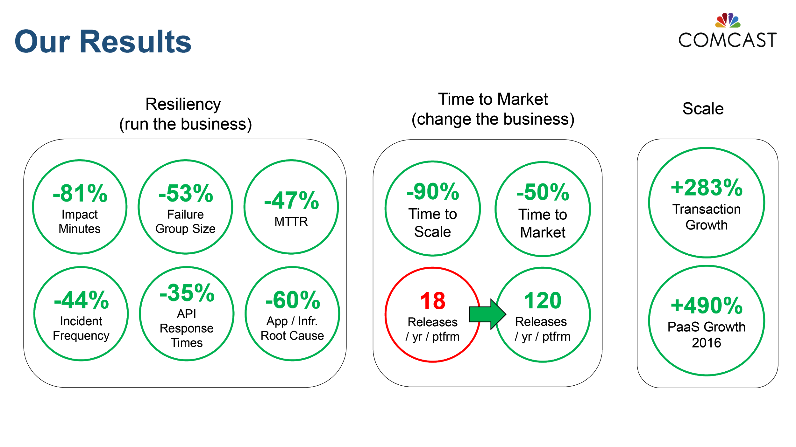
Comcast: Stability, Speed, Scalability with PCF
1,500+ Developers
5,000+ Applications
210M Daily Transactions
2X Faster Time to Market
80% Better Resiliency
10X Faster to Scale
25% ‘Oxygen’ increase
Source: Greg Otto, Executive Director, Cloud Services at Comcast, CF Summit June 2017
Notes:
Comcast moved from Oracle JEE to microservices framework using Spring Boot and Cloud, continuous delivery pipelines with Concourse (and Jenkins), Pivotal Cloud Foundry and DevOps
Comcast talk Replay: https://youtu.be/pfqSsjwCOqA

Slide 25
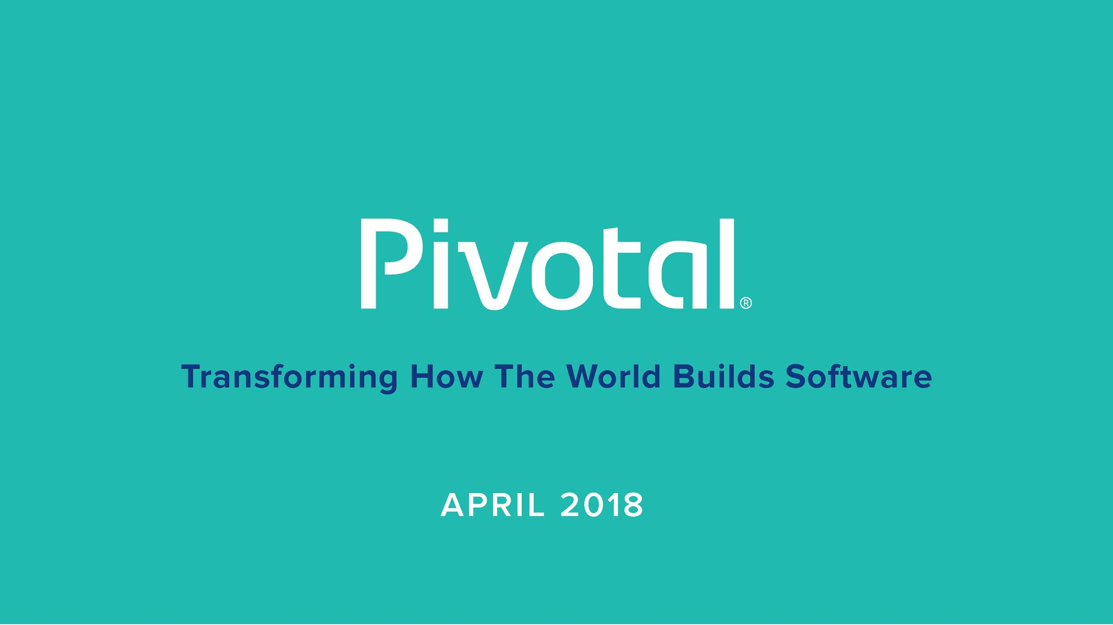
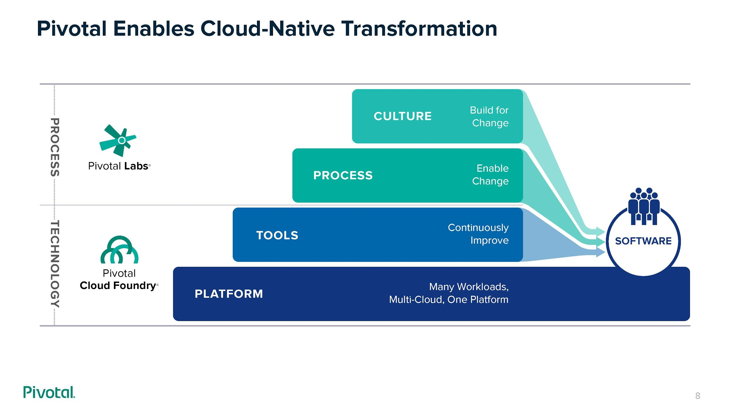

Slide 26

Transforming How The World Builds Software
© Copyright 2017 Pivotal Software, Inc. All rights Reserved.

